Slide 1


Connecting Kids to Justice -- Day Four

Slide 2
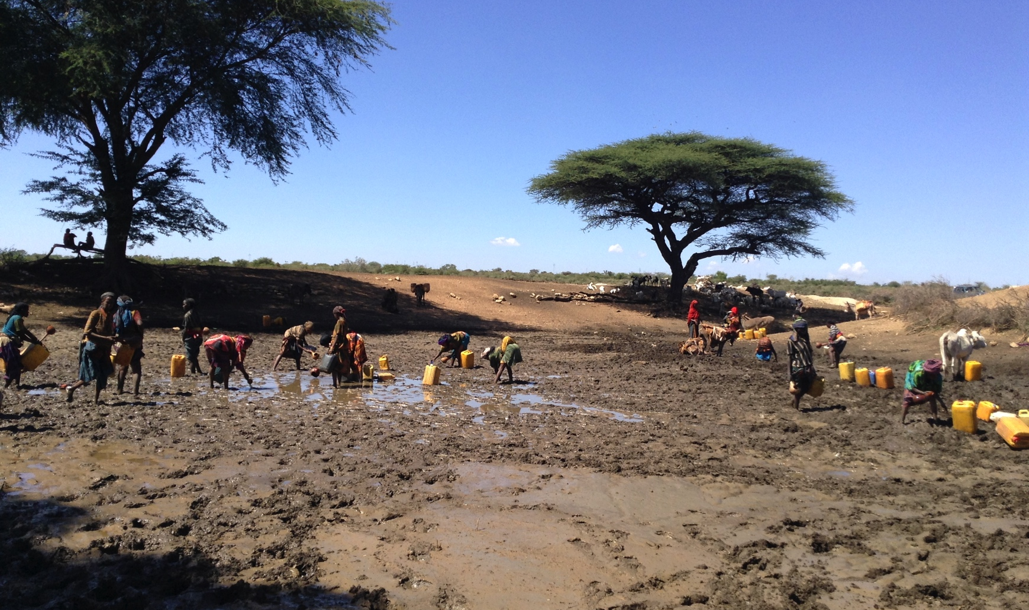
Before CRS Helped

Slide 3
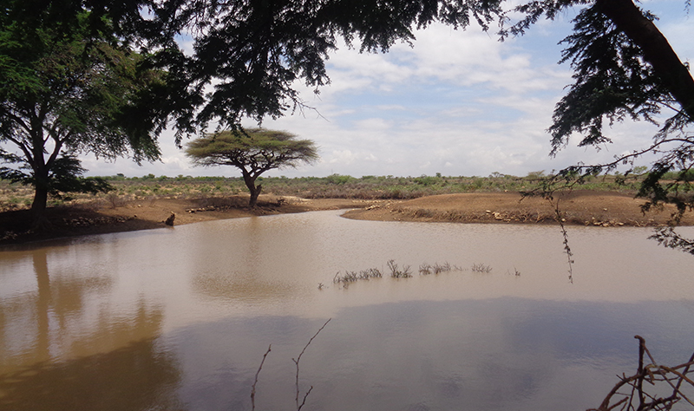
After!

Slide 4

Our Catholic Family
We have a family that loves and cares for us at home, and we are also an important part of the Catholic Family. God is a friend forever, and with God and his Church, we have a forever family, too!

Slide 5
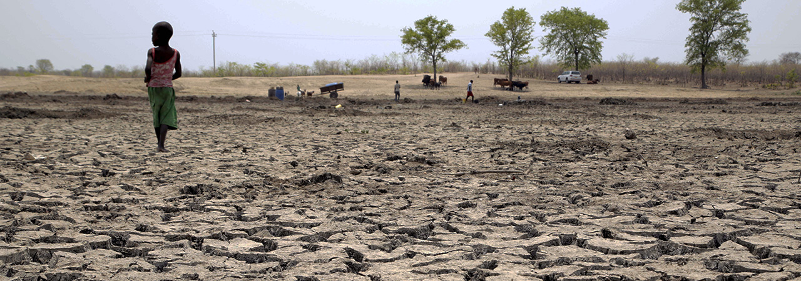
As members of the Catholic family, we know that it is important for us to love and care for the people in our family, especially people who are in need.

Slide 6
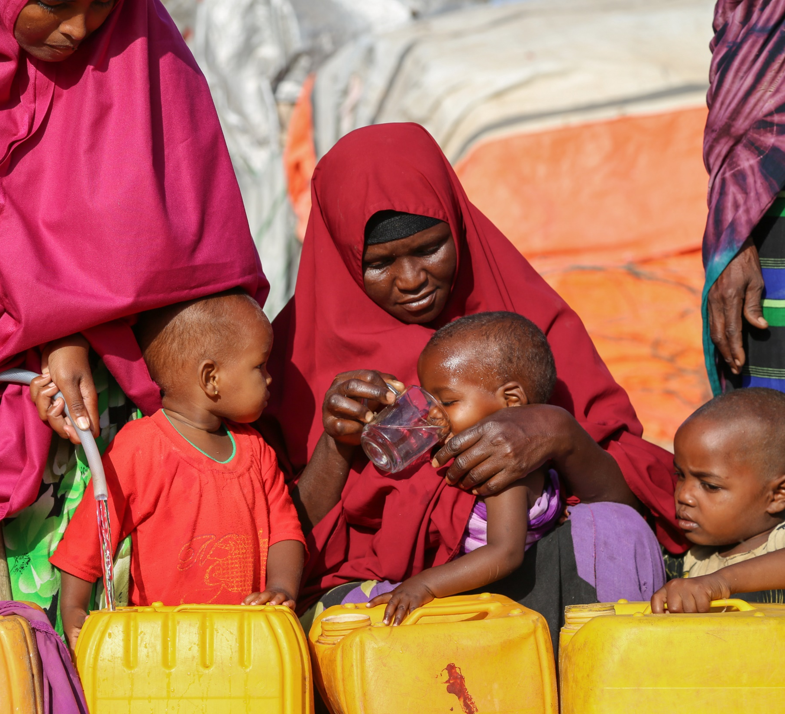
Catholic Social Teaching
As Catholics, we are called to help families, both in our community and around the world.

Slide 7
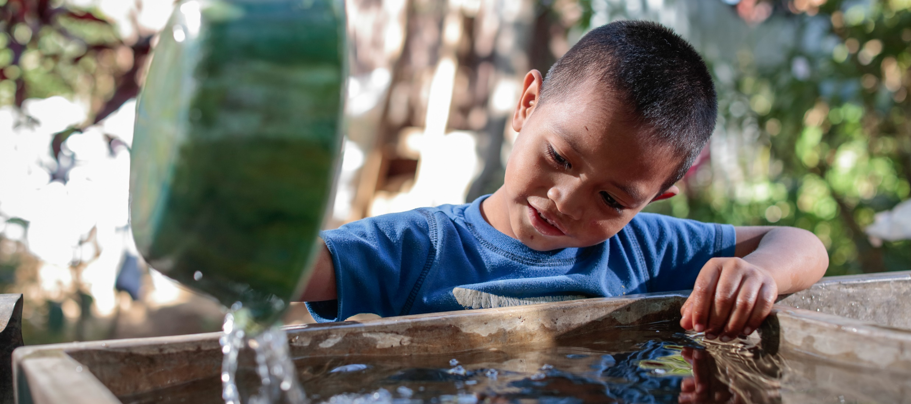
All week, we have talked about how the money we donate will help bring clean water to families around the world. You can make a big difference!

Slide 8
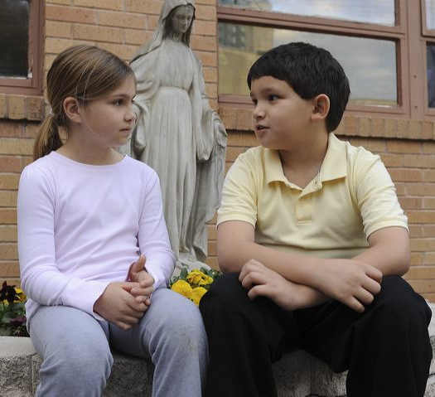
Talk About It
How do you help your family?
How can you help families around the world?
Jesus says that when you feed or care for “the least among us” you are caring for him. What do you think this means?

